Slide 1
Horizontal and vertical equity in the New Zealand tax system

Slide 2
Disclaimers
Statistics New Zealand disclaimer: Access to the data used in this study was provided by Statistics New Zealand under conditions designed to give effect to the security and confidentiality provisions of the Statistics Act 1975. The results presented in this study are the work of the author, not Statistics NZ.
Furthermore, Treasury has kindly given me access to facilities to undertake this research. However, the results presented here are the work of the author, not the Treasury.
In summary, any miscommunication or misinformation accidentally provided by this is purely my own fault.

Slide 3
What are Vertical and Horizontal equity? Typically defined with reference to pre-tax (market) income.
Vertical Equity
Horizontal Equity
When those who have more pay proportionally more.
But those who start with more end with more (no reranking).
Relates to the progressivity of the tax scale.
A specific type of unequal treatment of unequals.
Taxing someone to the point that their income falls below that of someone else (reranking) is unequal treatment – but is not vertical equity.
The equal treatment of equals.
How do we consider equals in a market income parade?
Do we need equals to discuss horizontal equity? (reranking)
What are equals in market income terms? (exact vs close equals)
What is equal treatment? (Same payment, proportional payments, progressive payments)

Slide 4
Policy change and justification
Two questions:
Was horizontal inequity reduced by policy changes?
Although redistribution declined was this offset by a more efficient effective tax schedule (lower HI and reranking)?
Period of interest – measured policy changes:
HES88-91 vs HES11-13
Reduction in top tax rate from 48% to 33%
Sizable reduction in real first tier transfer payments (declining up to 20%)
Increase in age of NZ Superannuation – although real payment growth occurred over 2000s, and surcharge was removed
Real value of family transfers increased with WfF
Stephens (2003) identifies the initial period as being characterised by
An increasing focus on productive efficiency (as opposed to economic concepts of allocative efficiency and equity)
A sharp movement away from vertical equity concerns which had remained important through the mid-1980s.
McClure (1999) notes the growing focus on work and targeting
Targeting rather than universality in the benefit system. Growing importance of supplementary assistance with reductions in level and accessibility of first tier benefits.
Income Tax Act 1994 explicitly introduced to reduce horizontal inequity.

Slide 5
The Gini coefficient, redistribution, and equity measures
Also called “potential redistribution due to
effective tax schedule”
No reference to equals. Can consider exact equals as groups (Aronson, Johnson, and Lambert (1994)) and use Bhattacharya (1967) decomposition of the Gini.
Between groups redistribution as vertical equity.
Within group redistribution as horizontal inequity.
Reranking/residual -> where the groups overlap
Effective tax schedule necessary for between group term. Use common tax-transfer rate for group.
Very few exact equals in the income distribution:
Creedy, van de Ven, and Lambert (2001): Close equal groups.
Select bandwidth/group size that maximises vertical term.

Slide 6
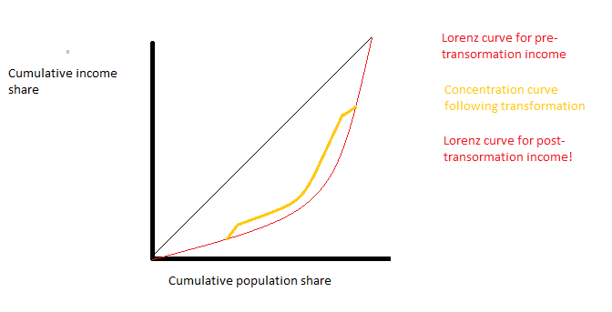
Picturing the curves
Say that someone at the top and someone at the bottom of the income parade swap position.

Slide 7
The Gini coefficient, redistribution, and equity: Missing reranking
Why would the two reranking terms , with and without equals, differ?
Lambert and Urban (2008) noted that using CEGs ignored two forms of reranking:
Within group reranking
Entire group reranking
Including these reranking terms implies that the vertical and horizontal terms are simply a decomposition of the
Kakwani vertical term.
V = Potential redistribution due to the effective tax schedule
H = Change in redistribution due to differential treatment of equals
R = Lost redistribution due to individuals changing position in the income parade

Slide 8
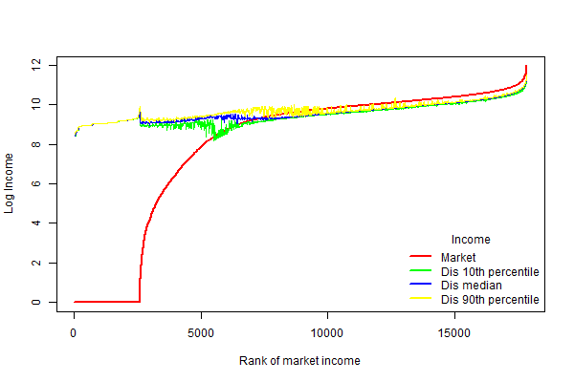
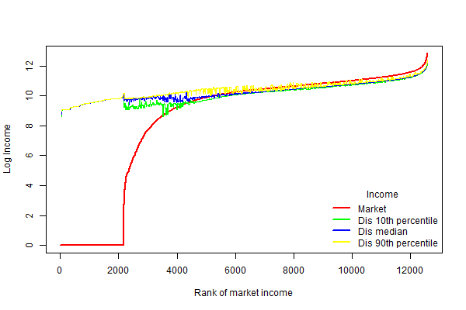
Market to disposable income
Concentrating on family income using modified OECD scale.
1988-91
Market Gini = 54.3
Disposable income Gini = 31.3
2011-13
Market Gini = 57.4
Disposable income Gini = 38.9

Slide 9
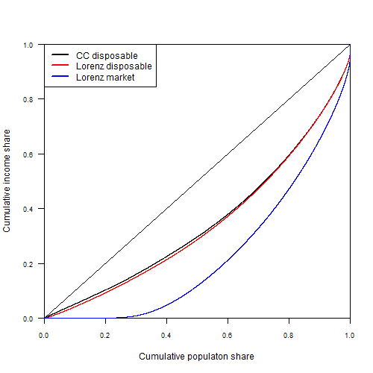
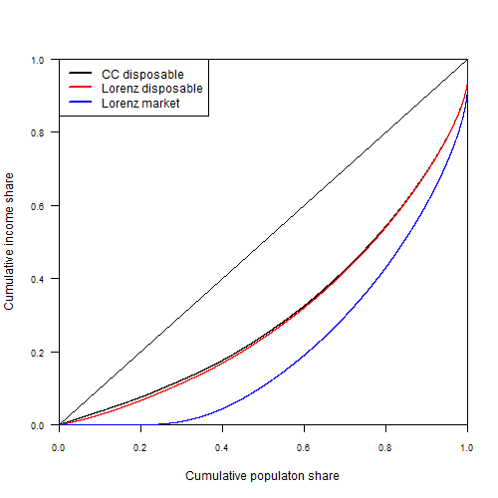
Vertical equity and reranking
1988-91
RE = 22.96 -> 42.3% of market Gini
Vk = 105.6% of RE
R = 5.6% of RE
2011-13
RE = 18.5 -> 34.1% of market Gini
Vk = 105.4% of RE
R = 5.4% of RE

Slide 10
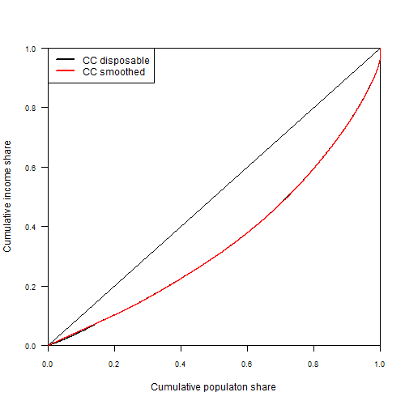
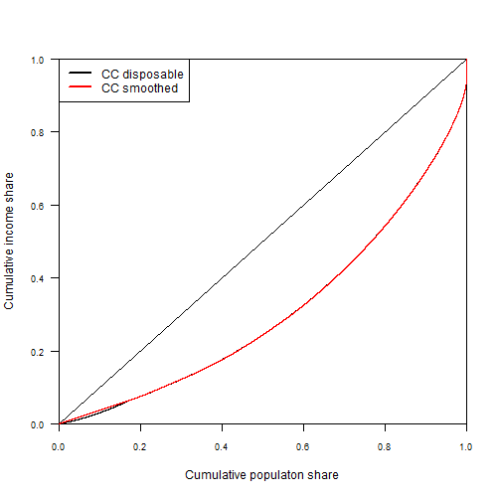
Disposable vs smoothed (HE) income
1988-91
2011-13

Slide 11
Horizontal inequity and reranking
Even with a measure of HI, what is relevant for horizontal inequity is complicated – current measure counts
reductions in inequality among equals as a reduction in HI.
Absolute rather than relative deviations (H vs Ht)
Reranking as horizontal inequity.
Preference is to show all three as potential violations of HE.
1988-91
H = 0.4% of RE
Ht = 0.8% of RE
R = 5.6% of RE
2011-13
H = 0.8% of RE
Ht = 1.5% of RE
R = 5.4% of RE
Horizontal inequity, judged via this measure, has worsened.
But is this a sign of policy failure or success?
Need and the unobservability of true equals.

Slide 12
Considering equals
The above analysis is premised on the idea that pre-tax income can be used to define equals with respect to tax and transfers.
This is questionable with regards to taxation alone.
This is extremely questionable with regards to the transfer system.
Reforms to the tax-transfer system have been focused on targeting need ahead of universality.
Using pre-tax income to define equals implies that this type of reform would increase measures of HI – even if from an equity standpoint we see it as HI reducing.
When looking at a policy with a clear definition of equals we can create clear equal groups. With broad tax-transfer policies what constitutes an “equal” is less certain.

Slide 13
Summing up
Redistribution inherent in the tax-transfer system declined between 1988 and 2013.
The redistributive potential of the tax-transfer system was also reduced.
Standard measures of horizontal inequity show that, at least in terms of tax-transfer changes HI did not decline.
However, insofar as the policy changes during this period were focused on targeting need standard measures of HI would report such targeting as horizontal inequity.
Evaluating horizontal inequity for a given policy requires a separate grouping of equals.
One suggestion to look at HI for broad tax-transfer changes (where groupings are less clear) is to use hypothetical income.

